Slide 1
Language and Brain

Slide 2
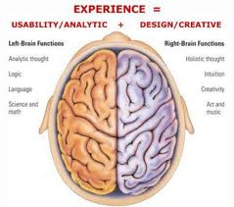

Slide 3
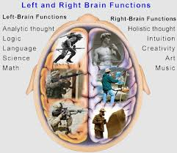

Slide 4
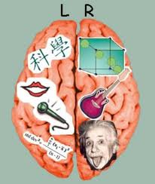

Slide 5
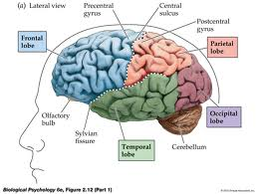

Slide 6
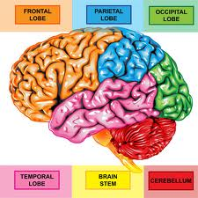

Slide 7
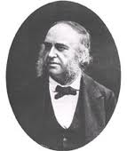
Broca’s Area

Slide 8
It is described as “ anterior speech cortex “. Paul Borca , a French surgeon , reported in 1960 that damage to this specific part of the brain was related to extreme difficulty in producing speech.

Slide 9
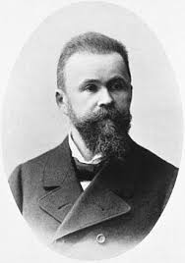
Wernick’s Area

Slide 10
It is described as “ posterior speech cortex “. Carl Wernick was a German doctor who , in the 1870s , reported that damage to this specific part of the brain is related to speech comprehension difficulties .

Slide 11
Motor Cortex An area that generally controls movement of muscles ( for moving hands , feet , arms , etc. ). Close to Broca’s area is the part of the motor cortex that controls the articulatory muscles of the face , jaw , tongue and larynx .

Slide 12
Work by Penfield and Robert in 1959 gave the evidence that this area is involved in the physical articulation of speech. They found that they could identify areas where the electrical stimulation would interfere with normal speech production.

Slide 13
Arcuate Fasciculus Is a bundle of nerve fibers discovered by Wernick and now is known to form a crucial connection between Wernick’s and Broca’s areas

Slide 14
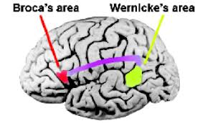

Slide 15
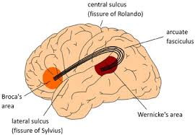

Slide 16
The Localization View Specific aspects of language can be accorded specific location in the brain. The brain would follow a definite pattern when involving in { hearing a word understanding it saying it }

Slide 17
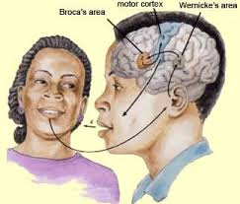

Slide 18
The Tip of the Tongue Phenomenon The tip-of-the-tongue phenomenon, (TOT), is the failure to retrieve a word from memory, combined with partial recall and the feeling that retrieval is imminent. The phenomenon's name comes from the saying, “ It's on the tip of my tongue.”

Slide 19
People in a tip-of-the-tongue state can often recall one or more features of the target word, such as the first letter. It is possible to hold the meaning of a word in one's mind without necessarily being able to retrieve its form.

Slide 20
Example: "What's the name of that stuff I wanted to tell your mother to use?" "Wait a second. I know." "It's on the tip of my tongue," she said. "Wait a second. I know." "You know the stuff I mean." "The sleep stuff or the indigestion?" "It's on the tip of my tongue." "Wait a second. Wait a second. I know."

Slide 21
Example: "You know, the actor guy! Oh, what is his name? See, the thing is, the thing is, the thing is that when I say his name, you'll go, 'Yes! The actor guy, love him, adore him . . ..' But I can't think of his name. It's on the tip of my tongue. You know who I mean. He's got the hair, the eyes, a bit of a nose, and a mouth, and it's all held together with, like, a face!"

Slide 22
The Slip of the Tongue It is a speech error which is sometimes called spoonerisms

Slide 23
Examples : Target: I saw you light a fire. Error: I saw you fight a liar. Target: clear blue sky Error: glear plue sky Target: spoon feeding Error: foon speeding

Slide 24
Examples - a cup of tea a tup of tea - black boxes black bloxes - feel better beel fetter

Slide 25
Slips of the ear An error of misperception in listening : mistaking a word or phrase for a similar-sounding word or phrase in speech or conversation.

Slide 26
Example : - “Mine is a long and sad tale !” said the Mouse, turning to Alice, and sighing. - “It is a long tail , certainly,”' said Alice, looking down with wonder at the Mouse's tail; “but why do you call it sad?”

Slide 27
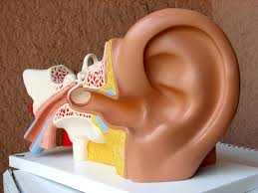
Example : - Great ape - Gray tape

Slide 28
Aphasia It is an impairment of language function due to localized brain damage that leads to difficulty in understanding and / or producing linguistic forms.

Slide 29
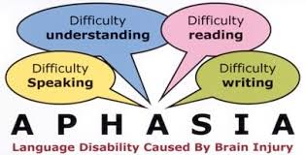

Slide 30
The most common cause of aphasia is a stroke ( when a blood vessel in the brain is blocked or bursts ) Someone who is aphasic has difficulties in understanding which leads to difficulties in production.

Slide 31
Broca’s Aphasia It is also called “motor aphasia”. It is characterized by a reduced amount of speech, distorted articulation and slow , often effortful speech. Speech of this type is called “agrammatical” ( the grammatical markers are missing ).

Slide 32
Example : I eggs and eat and drink coffee breakfast.

Slide 33
In Broca’s aphasia, comprehension is much better than production . This type of disorder can be quite severe and result in speech with lots of hesitation and really long pauses.

Slide 34
People with Broca’s aphasia : - Can have great difficulty forming complete sentences. - May get out some basic words to get their message across, but leave out words like “is” or “the.” - Often say something that doesn’t resemble a sentence. - Can have trouble understanding sentences. - Can make mistakes in following directions like “left, right, under, and after.”

Slide 35
Wernick’s Aphasia It is also called “ sensory aphasia”. It is the type of language disorder that results in difficulties in auditory comprehension . Someone suffering from this type can actually produce very fluent speech which is difficult to make sense.

Slide 36
People with Wernick’s aphasia suffer from anomia. Anomia is the difficulty in finding the correct word . To overcome anomia , speakers use different strategies such as trying to describe objects or talking about their purpose.

Slide 37
Conduction Aphasia A type of aphasia that has been associated with damage to the arcuate fasciculus. What the speaker hears and understands can’t be transferred successfully to the speech production.

Slide 38
People suffering from this disorder mispronounce words , but do not have articulation problems. They are fluent , but may have disrupted rhythm because of pauses and hesitation. Comprehension of spoken words is normally good . The task of repeating a word or phrase spoken by someone else creates major difficulty.

Slide 39
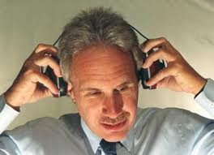
Dichotic Listening An experimental technique that has demonstrated a left hemisphere dominance for syllable and word processing.

Slide 40
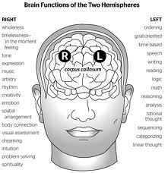
Anything experienced on the right-hand side of the body is processed in the left hemisphere, and anything on the left side is processed in the right hemisphere.

Slide 41
The right ear advantage When an individual is asked to say what was heard , he/she more often correctly identifies the sound came via the right ear

Slide 42
The Critical Period It is the period , during childhood , when the human brain is most ready to receive input and learn a particular language . It lasts from birth until puberty. If a child does not acquire language during this period , for any reason , then , he/she will find it almost impossible to learn language later on .

